Slide 1
Church Planter in Pastoral Journey
Dr. Paul Kim
BCNE Asian-American Church Planting Liaison
Executive Committee, SBC

Slide 2
Overview
Calling
Conviction
Challenge
Confirmation
Continuation

Slide 3
Calling
Time of Calling -God's Plan to be fulfilled in the generation (Esther, Daniel, Prophets...)
Purpose of Calling - God's warning for repentance from coming judgment (Flood, Slavery, Exile, Destruction of a nation)
Task for Calling - Noah, Abraham, Moses, Samuel, David, Prophets, Pastors, Missionaries, and Christian vocations in the ministry
Cost of Calling - (Acts 9:15; Hebrews 11)
Reward of Calling - (2 Timothy 4:7-8; 1 Peter 5:1-4)

Slide 4
Conviction
God's Plan - To be carried whatever it costs through the church planter
God's Will - To be done faithfully through the church planter
God's Salvation - To reach the lost through the church planter

Slide 5
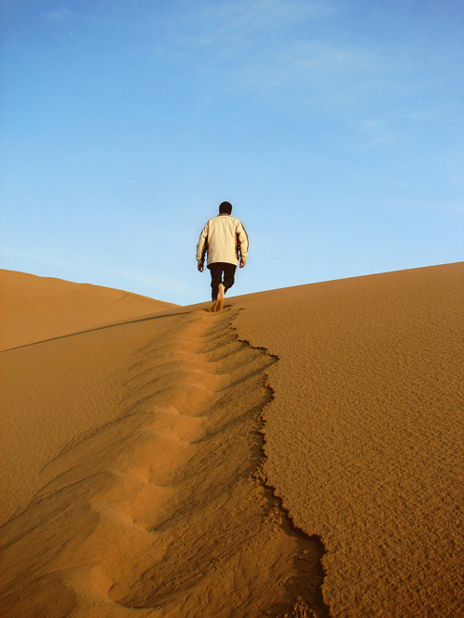
Challenge
Financial Challenge
Emotional Challenge
Leadership Challenge
Ministry Challenge - Preaching, Evangelism, Disciple Making, Prayers, Pastoral Counseling, Missions...

Slide 6
Confirmation
Growth
It may take 3-5 years with new disciples
They become homegrown workers
Joy – for encouragement
New believers
Baptism (by immersion)
Celebration
New Vision - Desire for new church planting & Global Missions
Continued education and professional growth
Continued personal and spiritual growth
Fellowship with fellow pastors
Mission trips

Slide 7
Continuation
Develop the Family of God - Koinonia Cross Relationship
Build up community of love and community of faith
Long-lasting commitment to the church ministry with purpose
Ownership of the church
Homegrown workers
Raise next generation leaders as disciple / pastors
Raise them up within the church family, not from outside

Slide 8
Continuation
Invest on People - Not on bricks
Baton - To pass the baton to next generation homegrown leaders
Multiplication of new DNA churches
New church shares the same spirit as mother church
Mother church provides support for new church
Financial
Manpower (sending teams)
Teams of church planters
Home and overseas

Slide 9
Questions and Answers
Webpage: www.bcne.net
Dr. Paul Kim BCNE Asian-American Church Planting Liaison Executive Committee, SBC
E-mail: pkim@sbc.net 617-877-1930 (M)

